Slide 1

Tips for Hosting a Great Party: Creating Unforgettable Experiences
Essential advice for unforgettable party planning
Notes:
AI-generated content may be incorrect. --- Hosting a successful party involves careful planning and creativity. In this presentation, we will cover essential tips for creating memorable experiences, from the initial planning stages to ensuring your guests have a fantastic time.

Slide 2

Agenda for Party Planning
Planning and Preparation
Invitations and Communication
Decorations and Ambiance
Food and Beverages
Entertainment and Activities
Hosting and Hospitality
Notes:
We will begin with the key elements of planning and preparation for your party. Following that, we will discuss invitations and communication, focusing on effective ways to reach your guests. Next, we'll explore decorations and ambiance, then dive into food and beverages. Lastly, we will cover entertainment and hospitality to ensure your event is a success.

Slide 3
Planning and Preparation
Notes:
The foundation of a great party lies in thorough planning and preparation. Understanding your goals, themes, and logistics will help set the tone for the entire event.

Slide 4

Choosing the Right Theme
Enhancing the Experience
A well-chosen theme can greatly enhance the overall experience of a party, making it more enjoyable for guests.
Guiding Decisions
The theme guides important decisions such as decorations, food choices, and activities to engage guests.
Considering Guests' Interests
It's essential to consider the interests of your guests and the occasion to select an appropriate theme.
Notes:
Selecting a theme can enhance the party experience and guide your decisions on decorations, food, and activities. Consider your guests' interests and the occasion when choosing a theme.

Slide 5

Creating a Guest List
Importance of a Guest List
A well-curated guest list ensures that guests contribute to a fun and engaging atmosphere, making the event enjoyable.
Guest Dynamics
Consider the dynamics between guests to foster connections and interactions that enhance the overall vibe of the event.
Setting the Vibe
Think about the overall vibe you want to achieve and select guests who complement that atmosphere.
Notes:
A well-curated guest list is crucial for ensuring that the right people come together to create a fun atmosphere. Think about the dynamics between guests and the overall vibe you want to achieve.

Slide 6
Setting a Budget
Importance of Budgeting
Establishing a budget helps you manage expenses effectively and prioritize essential spending.
Track Your Expenses
Tracking all expenses throughout the planning process is crucial to staying within your budget.
Prioritize Spending
Focus on essential elements like food, drinks, and entertainment to make informed spending decisions.
Notes:
Establishing a budget will help you manage expenses and prioritize spending on essential elements like food, drinks, and entertainment. Ensure to track all expenses throughout the planning process.

Slide 7
Invitations and Communication
Notes:
Effective communication sets the stage for your party. Invitations should convey all necessary information while piquing guests' interest.

Slide 8

Designing and Sending Invitations
Theme Consideration
Consider the theme of the event when designing invitations to create a cohesive look.
Visual Appeal
Ensure that invitations are visually appealing to capture the attention of guests.
Essential Details
Clearly state the date, time, location, and RSVP details on your invitations for clarity.
Notes:
Consider the theme when designing your invitations. Whether digital or physical, ensure that they are visually appealing and clearly state the date, time, location, and RSVP details.

Slide 9

Using Social Media and Digital Tools
Promoting Your Event
Social media can significantly increase visibility and reach for your event, attracting more participants and attendees.
Engaging with Guests
Utilizing social media allows for real-time engagement and interaction with guests, enhancing their overall experience.
Event Pages and Groups
Creating dedicated event pages or groups simplifies communication and updates, keeping everyone informed and connected.
Notes:
Social media platforms can be a valuable tool for promoting your event and engaging with guests. Create an event page or group for easy communication and updates.

Slide 10

Tracking RSVPs and Follow-Ups
Importance of RSVPs
Tracking RSVPs helps in organizing food and seating arrangements effectively for events.
Follow-Up Process
Following up with guests who haven't responded ensures an accurate headcount and helps in better planning.
Notes:
Keeping track of RSVPs is essential for planning food and seating arrangements. Follow up with guests who haven't responded to ensure you have an accurate headcount.

Slide 11
Decorations and Ambiance
Notes:
The right decorations and ambiance can transform your space and set the mood. Consider the theme and ensure that every element enhances the overall experience.

Slide 12

Selecting Appropriate Decorations
Theme Complementation
Selecting decorations that align with your theme enhances the overall aesthetic of your event, creating a cohesive look.
Inviting Atmosphere
Decorations like table centerpieces and streamers help to create an inviting and warm atmosphere for guests.
Decorative Variety
Using a variety of decorative items such as banners and centerpieces brings visual interest and excitement to the event.
Notes:
When choosing decorations, think about how they complement your theme. Use items like table centerpieces, streamers, and banners to create an inviting atmosphere.

Slide 13

Lighting and Music
Creating Ambiance
Lighting and music significantly influence the atmosphere of an event. Properly setting the mood enhances guest experiences.
Lighting Techniques
Use soft lighting for intimate gatherings and bright lights to energize parties, ensuring the lighting aligns with the event theme.
Music Selection
Choosing the right playlist is crucial. Match music themes and vibes to the type of event for an engaging atmosphere.
Notes:
Lighting and music play a vital role in creating ambiance. Use soft lighting for intimate settings or bright lights for energetic parties. Choose a playlist that matches the theme and vibe of your event.

Slide 14
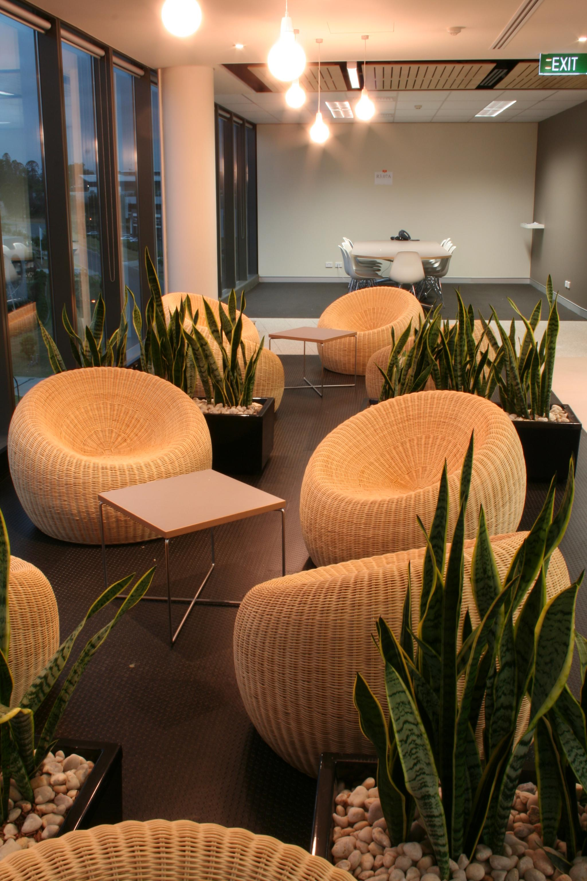
Setting up the Party Space
Furniture Arrangement
Arrange furniture in a way that promotes easy movement and encourages conversations among guests to create a welcoming atmosphere.
Designated Areas
Create separate areas for dining, dancing, and relaxing to ensure guests can enjoy different activities comfortably.
Decorations
Use decorations that enhance the party theme and atmosphere while ensuring they do not obstruct movement or conversation.
Notes:
Arrange furniture and decorations to facilitate movement and conversation among guests. Ensure there are designated areas for dining, dancing, and relaxing.

Slide 15
Food and Beverages
Notes:
Food and beverages are central to any successful party. Planning and catering options should align with your guests' preferences and dietary needs.

Slide 16
Planning the Menu
Time of Day Consideration
When planning your menu, consider the time of day to match the meal with appropriate options.
Theme Relevance
Ensure that your menu aligns with the overall theme of the event for a cohesive experience.
Variety and Balance
Offer a wide variety of options to cater to different tastes and ensure a balanced spread.
Notes:
Consider the time of day and theme when planning your menu. Offer a variety of options to cater to different tastes and create a balanced spread.

Slide 17
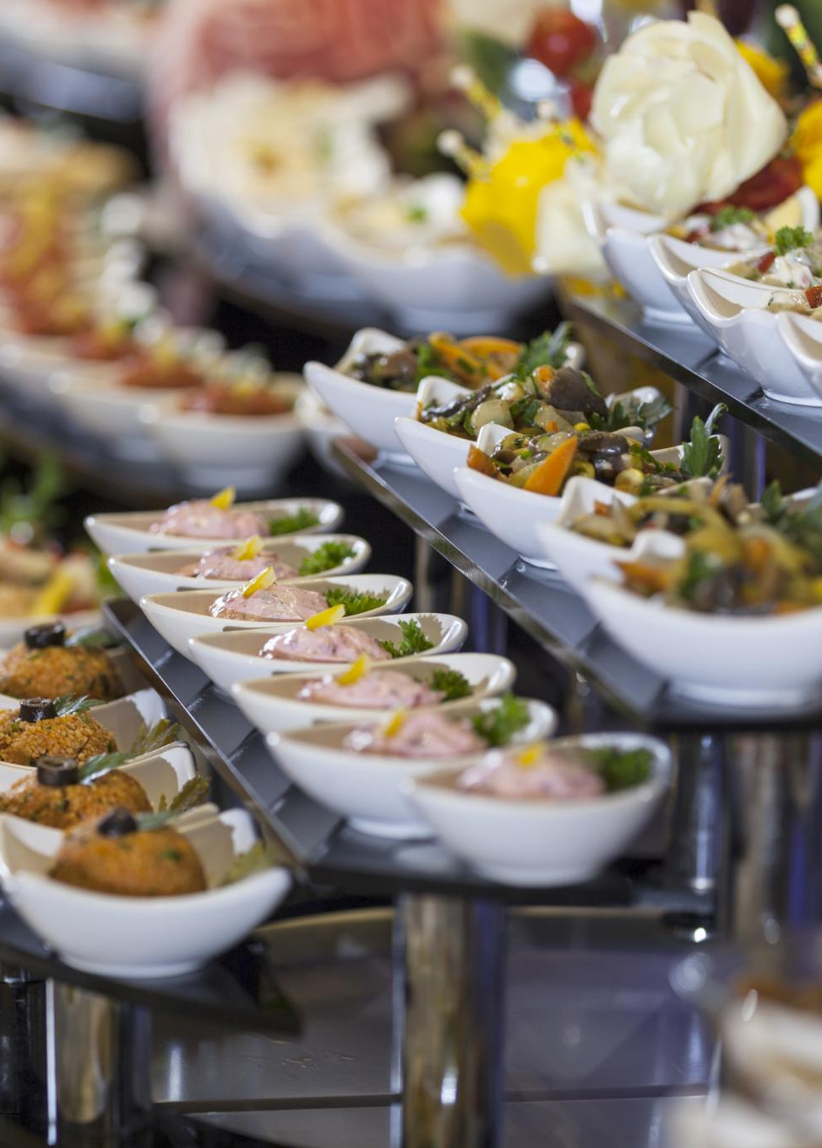
Catering Vs. Homemade Options
Catering Services
Hiring catering services can save significant time and effort, allowing hosts to focus on other event details.
Homemade Food
Preparing food at home can provide a personalized touch and create memorable experiences for guests.
Time Management
Consider the time required for meal preparation versus the convenience of outsourcing to caterers.
Notes:
Decide whether to hire catering services or prepare food on your own. Catering can save time, while homemade options often add a personal touch to the event.

Slide 18
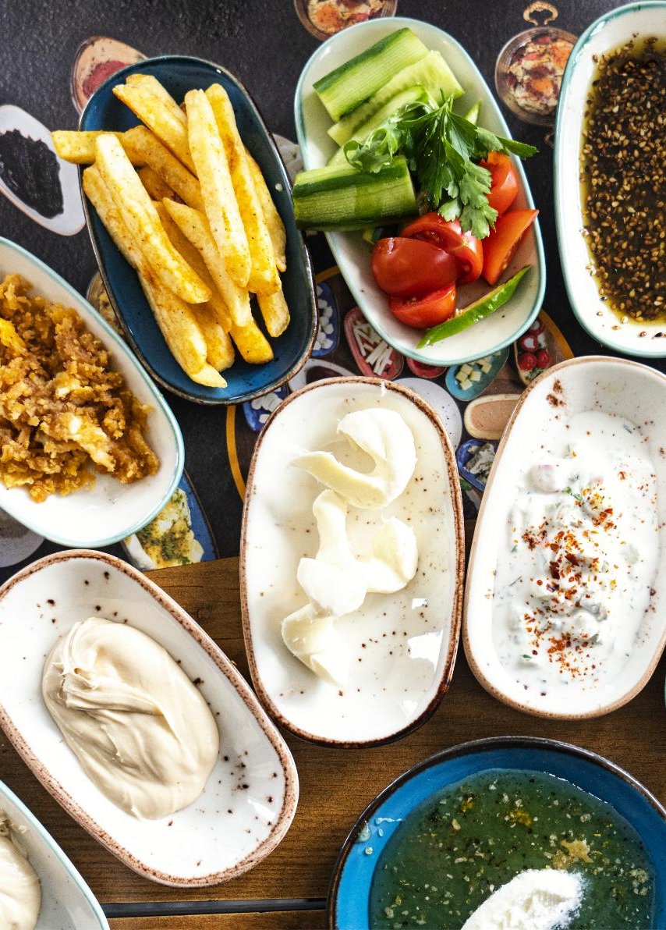
Managing Dietary Restrictions
Inclusive Menu Options
Offering a variety of menu options ensures all guests feel included and can enjoy their meals together.
Vegetarian and Vegan Choices
Providing vegetarian and vegan dishes caters to guests who avoid animal products, enhancing their dining experience.
Gluten-Free and Allergy-Friendly
Including gluten-free and allergy-friendly options ensures that guests with specific dietary needs can safely enjoy the meal.
Notes:
Be mindful of your guests’ dietary restrictions by offering inclusive menu options. Consider vegetarian, vegan, gluten-free, and allergy-friendly choices to ensure everyone can enjoy the food.

Slide 19
Entertainment and Activities
Notes:
Engaging activities keep the energy alive at your party and provide entertainment for guests. Choose options that align with the theme and the interests of your crowd.

Slide 20

Choosing Party Games and Activities
Encourage Interaction
Select games that promote interaction among guests, enhancing their social experience and enjoyment.
Fun Icebreakers
Incorporate fun icebreakers to help guests get to know each other and feel comfortable.
Team Games
Organize team games that encourage collaboration and teamwork, fostering connections among guests.
Notes:
Select games and activities that encourage interaction and participation. Fun icebreakers or team games can help guests mingle and foster connections.

Slide 21

Hiring Performers or DJs
Enhancing the Event Experience
Hiring entertainers like DJs or live musicians can significantly elevate the overall experience of your event.
Matching Entertainment to Mood
It's crucial to select entertainment that aligns with the mood you wish to create for your event, whether it's upbeat or relaxed.
Notes:
Consider hiring entertainers, such as DJs or live musicians, to elevate the experience. Ensure the style of entertainment matches the mood you wish to create.

Slide 22

Creating a Balanced Schedule
Balanced Event Flow
A balanced schedule ensures that guests enjoy a mix of food, activities, and relaxation throughout the event.
Incorporating Flexibility
Flexibility in the schedule allows for adjustments based on guests' preferences, enhancing their overall experience.
Food and Activities
Including diverse food options and engaging activities keeps the guests entertained and satisfied during the event.
Notes:
Organize the flow of the event with a balanced schedule that allows for food, games, and relaxation. Flexibility is key to adapting to guests’ preferences.

Slide 23
Hosting and Hospitality
Notes:
As the host, your role is to ensure that everyone feels welcomed and comfortable. Being attentive to your guests' needs contributes to their overall enjoyment.

Slide 24

Welcoming Guests and Introductions
Warm Greetings
Greet guests with a smile and friendly demeanor to create an inviting atmosphere from the start.
Introductions to Others
Introduce guests to one another to foster connections and build relationships among attendees.
Encouraging Conversations
Facilitating introductions helps break the ice and encourages engaging conversations among guests.
Notes:
Greet guests warmly upon arrival and introduce them to others. This helps create a friendly atmosphere and encourages conversations among attendees.

Slide 25

Ensuring Guest Comfort and Safety
Guest Comfort
Providing adequate seating and refreshments is essential to ensure guest comfort and create a welcoming atmosphere.
Safety Management
Identifying and managing potential hazards in the party space is crucial for ensuring the safety of all guests.
Notes:
Pay attention to guest comfort by providing adequate seating and refreshments. Ensure safety by managing any potential hazards in the party space.

Slide 26

Handling Unexpected Situations
Preparation for Unexpected Events
Anticipating unexpected events, like bad weather, ensures you are ready to tackle challenges effectively.
Staying Calm and Adaptable
Remaining calm and adaptable during unforeseen circumstances helps maintain control and leads to better outcomes.
Discreetly Addressing Issues
Addressing issues discreetly, without causing panic, helps maintain a positive and professional atmosphere.
Notes:
Be prepared for unexpected events, such as bad weather or last-minute changes. Stay calm and adaptable, and address any issues discreetly to maintain a positive atmosphere.

Slide 27
Conclusion
Thoughtful Planning
Successful parties begin with careful planning that considers guest preferences and logistics for a seamless experience.
Attention to Detail
Small details, from decorations to seating arrangements, can significantly enhance the atmosphere and enjoyment of the party.
Unforgettable Experiences
Creating memorable moments through engaging activities and thoughtful gestures ensures guests leave with lasting impressions.
Notes:
Hosting a great party requires thoughtful planning and attention to detail. By focusing on these key areas, you can create unforgettable experiences that leave a lasting impression on your guests.

